Slide 1
FAMILIES AS PARTNERS
SUPPORTING RELATIONSHIPS, ROUTINES, AND RESOURCES
SESSION 2
Notes:
Families as Partners: Training Session 2A
*Take a moment to introduce yourself, and if you want, have the group introduce themselves as well. Consider using a warm welcome and an activity from the SEL Playbook (https://schoolguide.casel.org/uploads/2018/12/CASEL_SEL-3-Signature-Practices-Playbook-V3.pdf).

Slide 2
Families as Partners Sessions
Session One: Families as Partners Overview
Session Two: Deeper Dive Into Support Structures
Session Three: Celebrating Successful Partnerships
Notes:
Provide an overview of upcoming sessions:
Session One: Families as Partners Overview
Session Two: Deeper Dive Into Support Structures
Session Three: Celebrating Successful Partnerships
Please note that Session 2 will have multiple offerings, each diving deeper into best practices for supporting families as partners

Slide 3
Today’s objectives
Identify attributes of positive relationships, routines, and resources with families as partners
Discuss strategies to support relationships, routines, and resources with families as partners.
Share action steps to enhance relationships, routines, and resources with families as partners.
Notes:
Provide an overview of session objectives:
Identify attributes of positive relationships, routines, and resources with families as partners
Discuss strategies to support relationships, routines, and resources with families as partners.
Share action steps to enhance relationships, routines, and resources with families as partners.

Slide 4
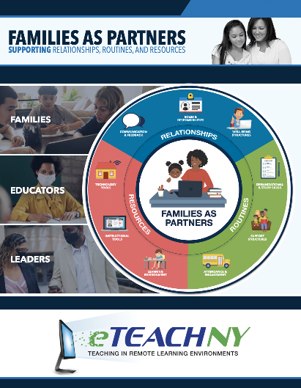
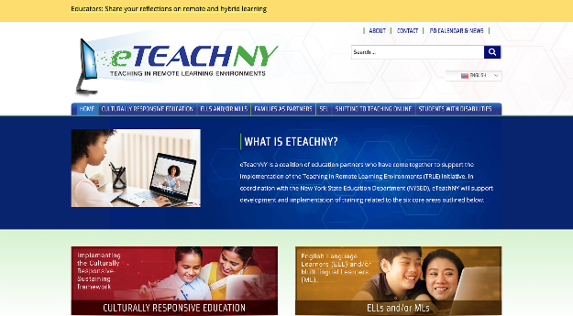
Materials needed
Access to the eTEACHNY Website
Families as Partners Slide Deck
Notes:
For today’s training, you will need a copy of this slide deck to guide conversations.
You’ll also want to visit eTEACHNY website - https://www.eteachny.org/. All of the resources shared today, plus future resources and resources from the other 5 areas of focus can be found on this website. You will want it in an easy place to return to and use.
Participants will benefit from having a printed or electronic version of the Supporting Relationships, Routines, and Resources Action Toolkit and the Activity Vignettes.

Slide 5
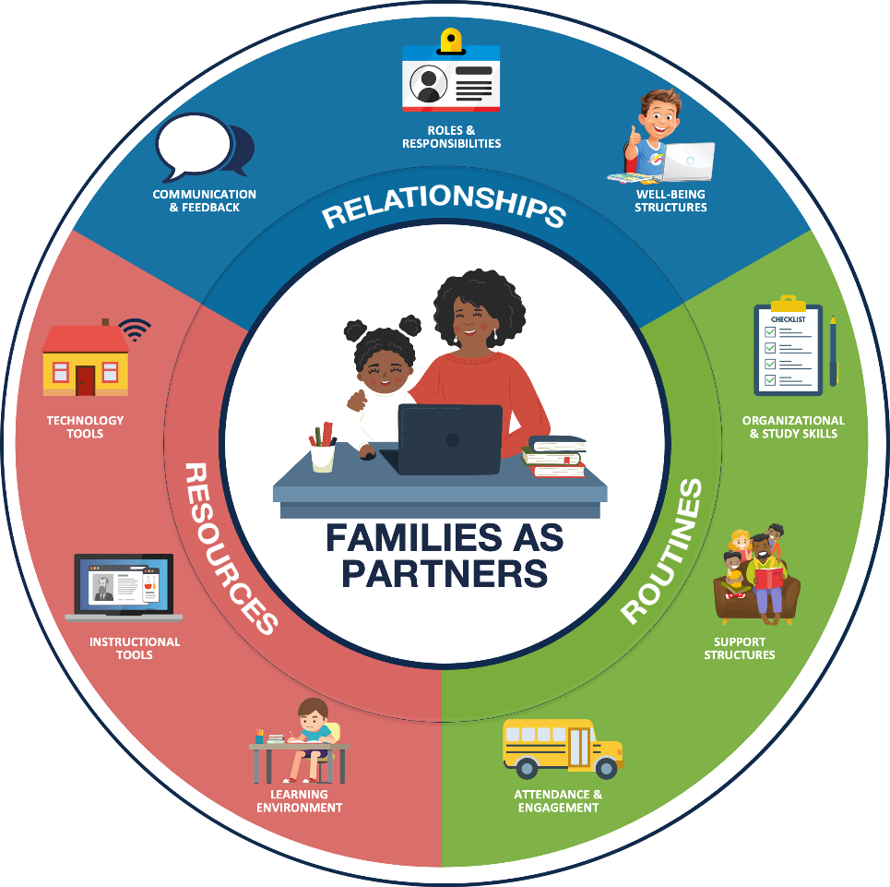
Foundation of partnership with families:
RELATIONSHIPS Positive connections that foster interaction and establish a nurturing environment of trust and support.
ROUTINES Rehearsed and predictable practices that provide structure to support efficient and effective learning.
RESOURCES Materials, Tools, and Supplies to support active learning and skill development.
Notes:
FOUNDATION OF PARTNERSHIP WITH FAMILIES: As teachers and leaders, we have always worked to develop and maintain positive experiences for students and families in our school buildings. We build relationships to foster positive connections and establish a nurturing environment of trust. We have routines in place that provide structure and support efficient and effective learning. Additionally, we ensure students have access to the materials, tools, and supplies needed to support active learning and skill development. Today we’ll look at how the pandemic has changed our approach - and as a result - how some of our newly adopted practices may change how we partner with families even after we return to fully in-person learning.

Slide 6
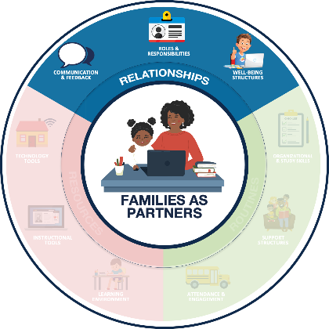
Relationships Positive connections that foster interaction and establish a nurturing environment of trust and support
COMMUNICATION & FEEDBACK
ROLES & RESPONSIBILITIES
WELL-BEING STRUCTURES
Foster two-way communication (e.g., Minimize education jargon and use preferred communication channels)
Provide (actionable and regular) personalized information
Defining the team and the standard operating procedures
Managing expectations for all partners
Prioritize physical and emotional well-being
Promote Balance (e.g., allow breaks)
Notes:
RELATIONSHIPS:
Communications & Feedback: Fostering two way communication and personalizing information for families.
Roles & Responsibilities: Identifying the team and determining how you will work together to successfully manage expectations within the partnership.
Well-being Structures: Prioritization of physical and emotional well-being to promote balance.

Slide 7
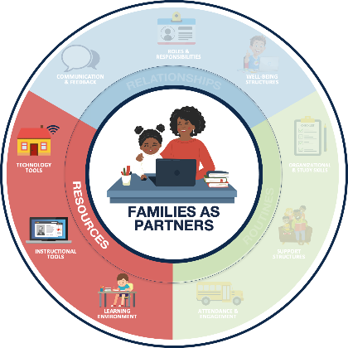
Resources Materials, Tools, and Supplies to support active learning and skill development.
LEARNING ENVIRONMENT
INSTRUCTIONAL TOOLS
TECHNOLOGY TOOLS
Dedicate a space for learning
Maintain an organized learning space
Leverage high-quality digital and print learning resources
Leverage consistent platforms across the district, when possible
Support access to devices and internet
Provide technology support resources and structures
Notes:
RESOURCES:
Learning Environment: A dedicated and organized space for learning.
Instructional Tools: Leveraging consistent platforms and high-quality digital and print resources.
Technology Tools: Access to devices, internet and technology support for these resources.

Slide 8
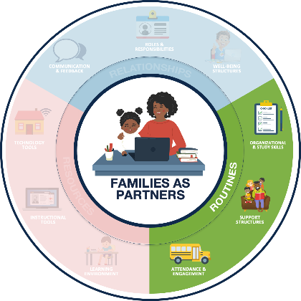
Routines Rehearsed and predictable practices that provide structure to support efficient and effective learning.
ORGANIZATIONAL & STUDY SKILLS
SUPPORT STRUCTURES
ATTENDANCE & ENGAGEMENT
Establish age-appropriate remote learning routines (e.g., setting weekly goals)
Encourage development of study skills (e.g., note taking templates)
Encourage students to reflect, identify needs, and seek help
Establish support routines (e.g., guardian learning office hours)
Foster regular communication about student attendance
Identify learning priorities and offer flexible structures (e.g., manageable and meaningful tasks
Notes:
ROUTINES:
Organizational & Study Skills: Establishing learning routines and developing study skills.
Support Structures: Encouraging students to seek help when needed and establish routines to support those needs.
Attendance & Engagement: Fostering regular communication and flexible structures to promote student attendance and engagement.

Slide 9
How has COVID-19 impacted teaching and learning?
FAMILIES
EDUCATORS
LEADERS
The role of families in the learning process has shifted, putting new demands on parents and caregivers.
Parents, siblings, grandparents, daycare providers, and other partners are supporting learners while attending to other responsibilities.
Educators have taken on the challenge of shifting teaching and learning into remote formats.
Teachers are developing relationships, adjusting routines, and leveraging resources to support family partnerships and student learning.
Administrators have fostered the transition of traditional partnering practices into remote/hybrid learning environments.
Leaders are adjusting remote/hybrid learning plans based on feedback from educators and families.
Notes:
HOW COVID HAS IMPACTED FAMILIES, EDUCATORS, AND LEADERS:
FAMILIES: Parents, siblings, grandparents, daycare providers, and other partners are supporting learners while continuing to attend to other responsibilities. (i.e. balancing work, family needs, caring for multiple students at once, etc.)
EDUCATORS: Educators are developing relationships in new ways; adjusting routines and leveraging a variety of new resources to support the family and student learning partnerships.
LEADERS: Educational leaders are transitioning traditional effective partnering practices and adjusting plans based on feedback from educators and families.
*After setting the scene, you might consider a share out activity or even a brain break if you notice participants are wearing out. Checkout the engaging strategies and brain break ideas in the SEL Playbook from CASEL (https://schoolguide.casel.org/uploads/2018/12/CASEL_SEL-3-Signature-Practices-Playbook-V3.pdf)

Slide 10
Let’s dive in
How to use the families as partners resources
Notes:
The remainder of this training is going to focus on remote/hybrid learning scenarios that educators might have encountered during the pandemic (activity vignettes); as well as resources to aid educators in successfully navigating family partnerships in remote/hybrid learning environments (action toolkit).
*Handout or ensure participants have access to the Supporting Relationship, Routines, and Resources Action Toolkit and Activity Vignettes

Slide 11
Families as partners Activity Vignettes
https://www.eteachny.org/families-as-partners/
Notes:
The activity vignettes are a tool used to explore practical scenarios educators might be encountering while supporting family partnerships in a remote or hybrid learning environment.

Slide 12
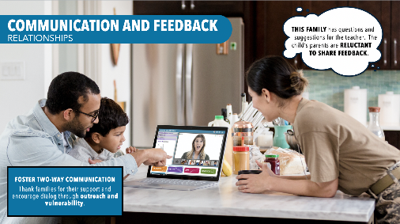
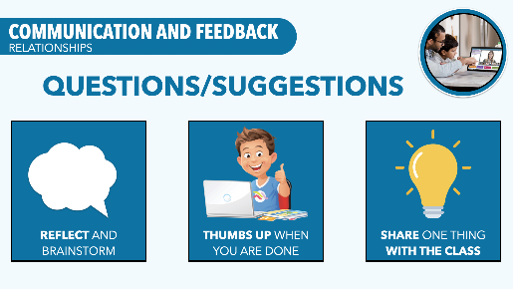
Each vignette is composed of five slides
Vignette Topic
Strategy & Scenario
Considerations
Research
Action
Notes:
About the Activity Vignettes: The vignettes are broken into 5 slides.
Vignette Topic
Action Strategy & Setting the Scene
Educator Considerations
Research/Evidence-based best practices
Actions to take
Vignettes also have opening slides with the families as partners circle and a closing slide with a list of the nine action strategies to utilize. Vignettes are grounded in research. Footnotes to sources are provided as well.

Slide 13
Families as partners Action Toolkit
https://www.eteachny.org/families-as-partners/
Notes:
The Supporting Relationships, Routines, and Resources Action Toolkit is a pdf resource filled with action ideas and research grounded information to inspire collaborative conversations.

Slide 14
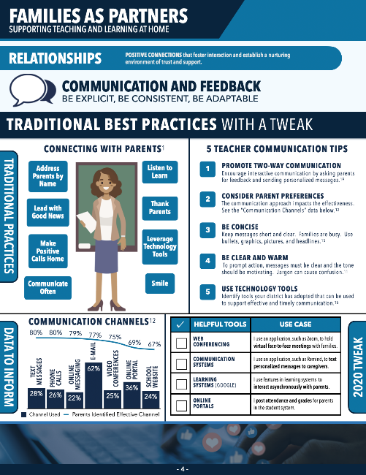
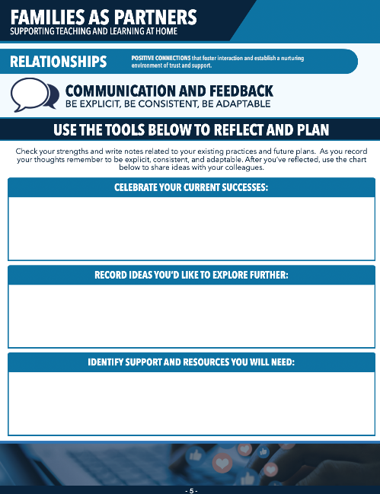
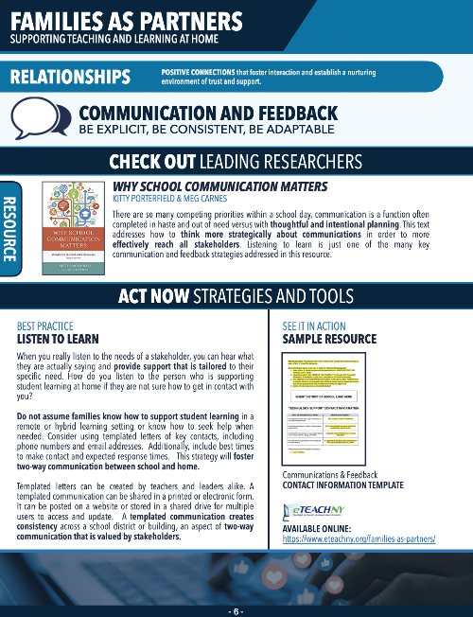
Each section is composed of three sections
Overview
Note Catcher
Tools
Notes:
About the Action Toolkit: The toolkit is broken into 3 sections.
An overview page
A note catcher page
A page of resources and tools
The toolkit also has an opening page with the families as partners circle. This toolkit is grounded in research. Footnotes to sources are provided as well at the end of the toolkit.

Slide 15
MODEL THE PRACTICE
Notes:
Once participants have been introduced to the resources developed to support this professional development session, there are a variety of ways you could proceed with your PD offering.
*One method for delivery is to model how to use the tools and then provide participants the chance to walk through the tools independently. Also, if participants have taken the Families as Partners Self-Reflection Survey, they might want to use those results to help them focus in a on a particular subcategory topic. Consider setting a timer for participants or giving them a time that the group will reconvene together. An engaging strategy could be employed for collaborative conversations. Additionally, you might want to consider a share out activity or even a brain break if you notice participants are wearing out. Checkout the engaging strategies and brain break ideas in the SEL Playbook from CASEL (https://schoolguide.casel.org/uploads/2018/12/CASEL_SEL-3-Signature-Practices-Playbook-V3.pdf)

Slide 16
Communication & Feedback Activity Vignette
Notes:
To model the practice, we will look at the first subcategory of Relationships, which is Communication & Feedback
SLIDE 7
Vignette #1: Communication and Feedback

Slide 17
Communication & Feedback Activity Vignette 2
Notes:
SLIDE 8
Strategy: Listen to Learn
Setting the Scene: Today is a remote instruction day. This example highlights a synchronous learning opportunity in which the student is being supported from home.
*You will notice as we move through the vignette slides that more than one strategy could be employed in the scenario. Future resources will address other strategies and tools an educator might use in the situation to enhance the family-school partnership.

Slide 18
Communication & Feedback Activity Vignette 3
Notes:
SLIDE 9
Providing a safe space that encourages dialog through outreach and vulnerability will create stronger relationships with families as partners. In order to listen to learn, ensure consistent feedback routines are implemented, families are intentionally involved, and that as the educator, you take the time to listen and respond appropriately.

Slide 19
Communication & Feedback Activity Vignette 4
Notes:
SLIDE 10
Research shows, when you take the time to listen, it makes a big impact on relationships with students and families. Remember, a family can be mom and dad, brothers or sisters, grandparents, aunts and uncles, caregivers, day care providers, or anyone who is support student learning in a remote or hybrid environment.

Slide 20
Communication & Feedback Activity Vignette 5
Notes:
SLIDE 11
Listening to learn requires an educator to build time into a learning opportunity. Some tactics you might want to try to foster two way communication is to provide a time for learners and their helpers to reflect and brainstorm. Using thumbs up as a way to know all learners have adequate time to think about and share any questions they might have during the learning. A third options might be to ask each student to share one point of learning or question about the learning they have with the class. Helpers can be asked to engage in this practice too.
Additional resources and tools are available in the action toolkit located on the eteachny website.
*An engaging strategy could be employed for collaborative conversations. Additionally, you might want to consider a share out activity or even a brain break if you notice participants are wearing out. Checkout the engaging strategies and brain break ideas in the SEL Playbook from CASEL (https://schoolguide.casel.org/uploads/2018/12/CASEL_SEL-3-Signature-Practices-Playbook-V3.pdf)

Slide 21
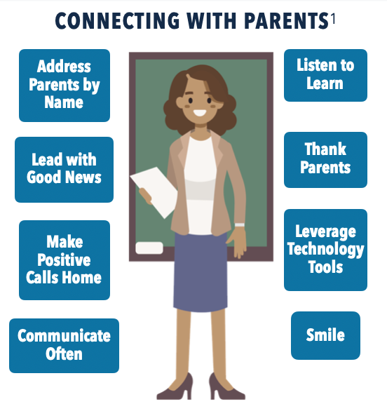
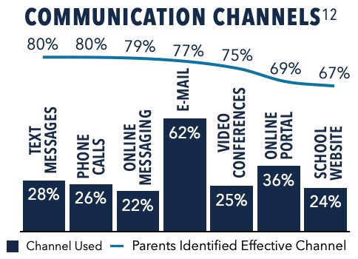
Communication & Feedback Action Toolkit
Notes:
PAGE 4
Let’s take a deeper look at communication and feedback.
*Select any graphics and dive into the content.
*An engaging strategy could be employed for collaborative conversations. Additionally, you might want to consider a share out activity or even a brain break if you notice participants are wearing out. Checkout the engaging strategies and brain break ideas in the SEL Playbook from CASEL (https://schoolguide.casel.org/uploads/2018/12/CASEL_SEL-3-Signature-Practices-Playbook-V3.pdf)

Slide 22
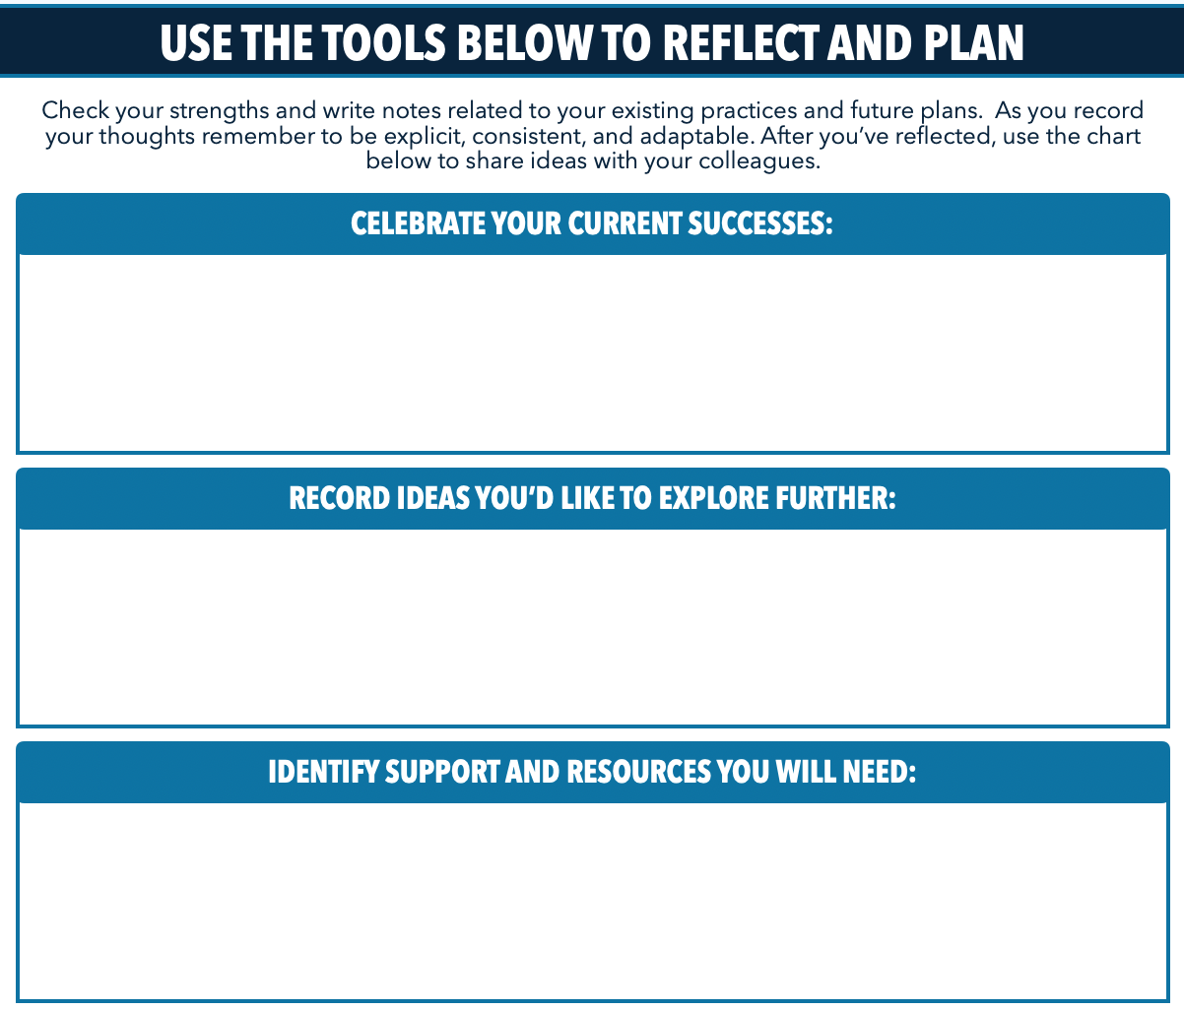
Communication & Feedback Action Toolkit 2
Notes:
PAGE 5:
Completing the Note Catcher
Now that we have a common understanding of communication and feedback in remote or hybrid learning environment, take time (either independently, in small groups, or as a whole group) to reflect, record, and plan. Ask participants keep this page on hand as more ideas might be generated as you move into the action toolkit.
*An engaging strategy could be employed for collaborative conversations. Additionally, you might want to consider a share out activity or even a brain break if you notice participants are wearing out. Checkout the engaging strategies and brain break ideas in the SEL Playbook from CASEL (https://schoolguide.casel.org/uploads/2018/12/CASEL_SEL-3-Signature-Practices-Playbook-V3.pdf)

Slide 23
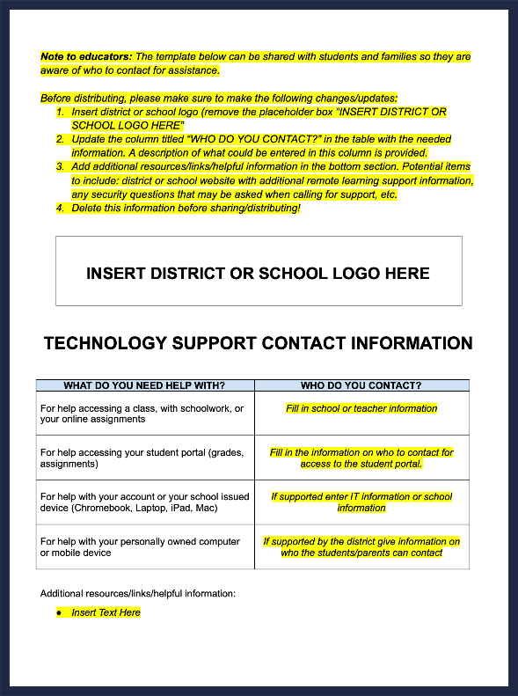
Communication & Feedback Action Toolkit 3
Notes:
PAGE 6
If you are interested in a text to reference about building communication practices, check out Why School Communication Matters. You can pick up this text tomorrow and start reading or in the next session we will share discussion questions or professional development opportunities related to this text.
Also, if you are looking to up your communication practice right away, check out the contact template provided for your use. If you want to turn this session into a make and take session, you could plan time for participants to fill out the contact information template.
*An engaging strategy could be employed for collaborative conversations. Additionally, you might want to consider a share out activity or even a brain break if you notice participants are wearing out. Checkout the engaging strategies and brain break ideas in the SEL Playbook from CASEL (https://schoolguide.casel.org/uploads/2018/12/CASEL_SEL-3-Signature-Practices-Playbook-V3.pdf)

Slide 24
Additional resources
Additional resources to support the development of positive partnerships with families and other remote learning priorities can be found online at eTeachny.org.
Shifting to Teaching Online
Families as Partners
Students With Disabilities
English Language and Multilingual Learners
Culturally-Responsive Education
Social Emotional Learning
Notes:
If you are looking for more resources related to families as partners or any of the other 5 categories of support, please go to https://www.eteachny.org/ to access countless resources to support educators during the transition to remote and hybrid learning environments.

Slide 25
Questions?
Notes:
This concludes Families as Partners: Training Session One. Questions?
*Consider ending using an optimistic closure from the SEL Playbook (https://schoolguide.casel.org/uploads/2018/12/CASEL_SEL-3-Signature-Practices-Playbook-V3.pdf).

